Slide 1










Software Technologies
Course Overview
Software Technologies
SoftUni Team
Technical Trainers
Software University
http://softuni.bg

Slide 2



Table of Contents
Course Objectives
Course Program
Trainers Team
Course Schedule
Exams and Evaluation
Learning Resources

Slide 3
Have a Question?
sli.do #1376

Slide 4



Software Technologies
Software Technologies
Course Objectives & Program

Slide 5

Course Objectives
The Software Technologies course provides the first steps in 4 technologies:
Front-end development with HTML, CSS and JavaScript
Web development with PHP and MySQL
Web development with C#, ASP.NET MVC, SQL Server and Entity Framework
Web development with Java, Hibernate and Spring MVC

Slide 6
Warning: This Course is at Very Basic Level
The course is very introductory
It will NOT teach you in HTML, CSS, JavaScript, PHP, MySQL, .NET, SQL Server, Entity Framework, ASP.NET MVC, Java, Hibernate and Spring MVC
It will make you familiar with these technologies
You get an idea how these technologies work
You will touch all of them in 3 months
You will create a simple blog system

Slide 7
Course Topics
Part I – HTML5 and JavaScript
HTML, CSS, JavaScript (syntax, functions, loops, objects, arrays)
Playing with DOM, jQuery, AJAX and REST services
Creating a blog with jQuery, HTML5, JS and Kinvey
Part II – PHP & MySQL
XAMPP, PHP basics, MySQL, creating a MVC framework
Creating a blog with PHP + MySQL + MVC framework

Slide 8


Course Topics (2)
Part III – C# Web Development
SQL Server, Entity Framework, ASP.NET MVC
Creating a blog with ASP.NET MVC + EF + SQL Server
Part IV – Java Web Development
Java basics, Hibernate, Spring MVC
Creating a blog with Java + Spring MVC + MySQL + Hibernate

Slide 9
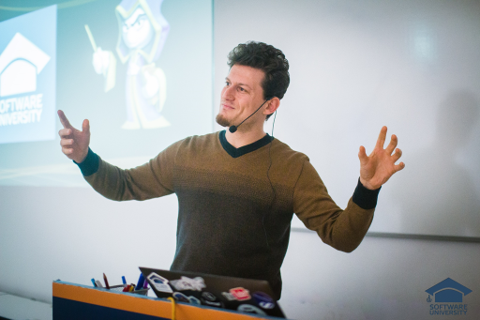
The Trainers Team

Slide 10
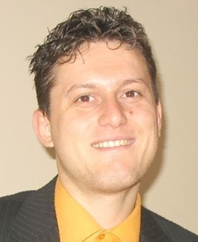
Trainers Team
Svetlin Nakov, PhD
Training & Inspiration Manager @ Software University
20+ years software development experience
10+ years experience as trainer
Author of 7 programming books
Winner in International programming contests and Olympiads
Speaker at hundreds of events
Web site & blog: www.nakov.com

Slide 11
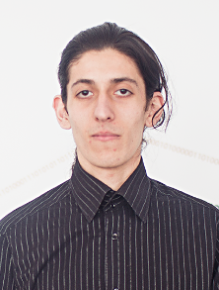
Trainers Team (2)
Simeon Sheytanov
Technical Trainer @ Software University
Top performing student from the Software University

Slide 12
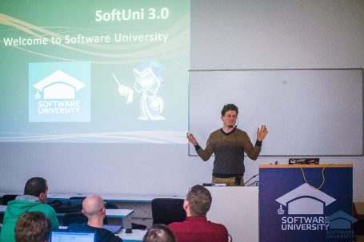


Software Technologies
Course Details and Schedule

Slide 13
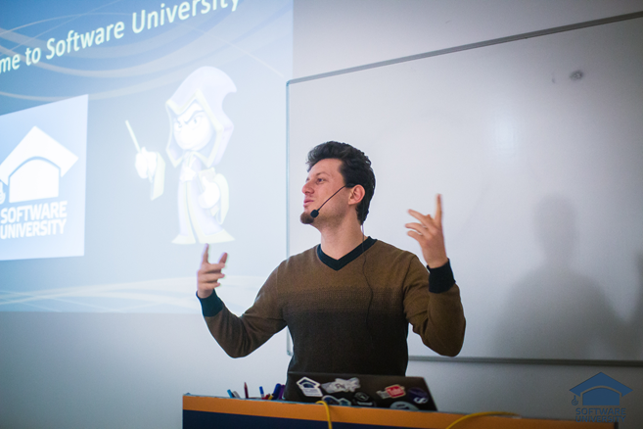
Training Duration and Schedule
Lessons: ~ 32 hours (onsite + YouTube videos)
Practical exercises (in class): ~ 120 hours
Homework: ~ 0-80 hours
Project defense: 0.5 hours
Allocation
Timeframe: June – September 2016
Exam: 1-2 September 2016

Slide 14


Why English?
Why the slides are in English?
English is the native language of the software engineers
Specific terminology should be in English
Translations are inaccurate and funny
Just learn English!
No excuses

Slide 15

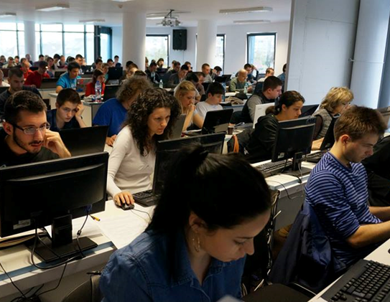
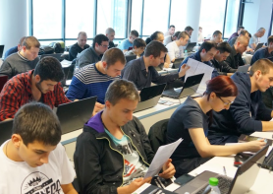
Software Technologies
Evaluation Criteria

Slide 16


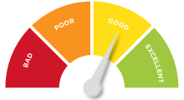
Scoring System for the Course
Practical project – 90%
Homework submissions – 10%
Forum activity – bonus up to 10%
Presence in class – 5% bonus

Slide 17


Homework Assignments
Your homework is mainly work in class!
Lesson days → slides + live demos + exercises
Exercise days → only exercises
How to submit your homework?
Some submitted in the judge system
Others uploaded in the course Web site
Homework assignments are due in 1 week

Slide 18

Teamwork / Practical Project
Choose one of the technologies
JavaScript or PHP or C# or Java
Build a team or work alone
Choose your teammates
Develop a practical project
Choose from existing projects
Or work on your own idea
Public defense → demonstrate your work live at SoftUni

Slide 19










Resources
What We Need Additionally?

Slide 20

Course Web Site & Forums
The Programming Basics official web site:
Register for the "Software University Forum":
Discuss the course exercises with your colleagues
Find solutions for all course exercises
Share source code / discuss ideas / help each other
https://softuni.bg/courses/software-technologies
https://softuni.bg/forum/categories/45

Slide 21

The Programming Basics Slides and Videos
All lecture slides, videos, homework assignments, projects and other resources are open content, available for free
Visit the course web site to access the course resources

Slide 22




Recommended Software
Software needed for this course:
WebStorm – https://jetbrains.com/webstorm/ – for HTML & JS
PhpStorm – https://jetbrains.com/phpstorm/ – for PHP
Visual Studio – https://www.visualstudio.com – for .NET
Eclipse for Java EE – https://www.eclipse.org – for Java

Slide 23








Software Technologies
https://softuni.bg/courses/software-technologies

Slide 24
License
This course (slides, examples, demos, videos, homework, etc.) is licensed under the "Creative Commons Attribution-NonCommercial-ShareAlike 4.0 International" license

Slide 25






Free Trainings @ Software University
Software University Foundation – softuni.org
Software University – High-Quality Education, Profession and Job for Software Developers
softuni.bg
Software University @ Facebook
facebook.com/SoftwareUniversity
Software University @ YouTube
youtube.com/SoftwareUniversity
Software University Forums – forum.softuni.bg

